Slide 1
Image processing
Perception in computer vision

Slide 2
definition
What is IMAGE PROCESSING?
The study of any algorithm that takes an image as input and returns an image or parameters as output
Includes:
Image display and printing
Image editing and manipulation
Image enhancement
Feature detection
Image compression

Slide 3
Digital image processing
What is DIP?
The use of computer algorithms to perform image processing on digital images
Two major tasks:
Taks 1 : Improvement of pictorial information for human interpretation
Task 2 : Render it more suitable for autonomous machine perception (processing of image data for storage, transmission and representation)

Slide 4
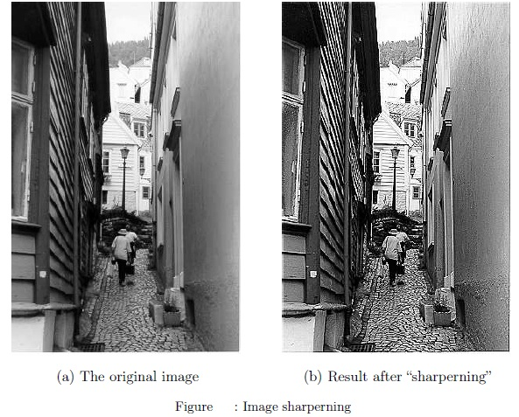
TASK 1 - Improvement of pictorial information for human interpretation
Enhancing the edges of an image to make it appear sharper

Slide 5
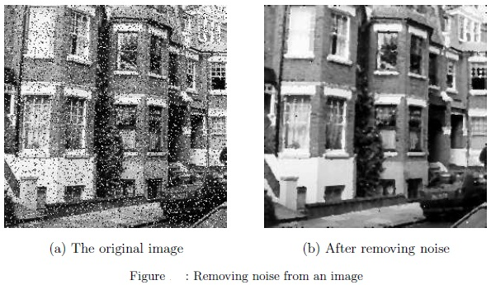
TASK 1 - Improvement of pictorial information for human interpretation
Removing noise from an image; noise being random errors to the image

Slide 6
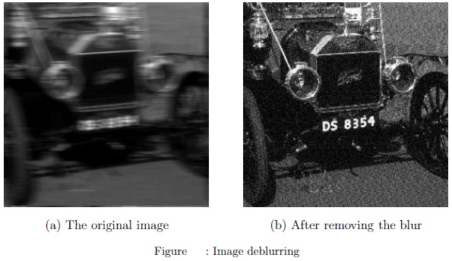
TASK 1 - Improvement of pictorial information for human interpretation
Removing motion blur from an image

Slide 7
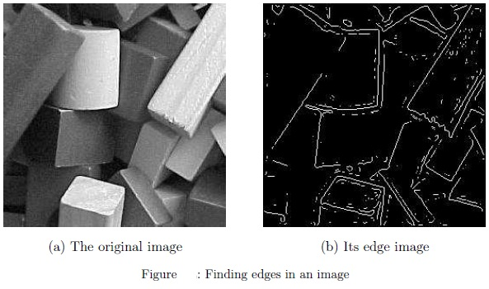
TASK 2 – Render it more suitable for autonomous machine perception
Obtain the edges of an image – necessary for measurement of objects

Slide 8
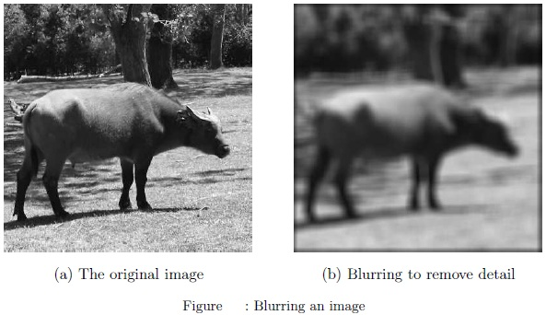
TASK 2 – Render it more suitable for autonomous machine perception
Removing detail from an image – to measure the necessary object and remove unnecessary details.

Slide 9
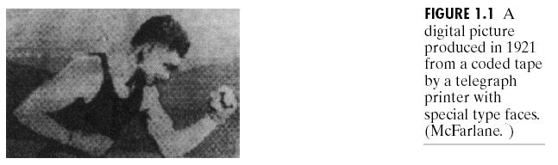
History of Digital Image Processing
Early 1920s: One of the first applications of digital imaging was in the news- paper industry
The Bartlane cable picture transmission service
Images were transferred by submarine cable between London and New York
Pictures were coded for cable transfer and reconstructed at the receiving end on a telegraph printer
Early digital image

Slide 10
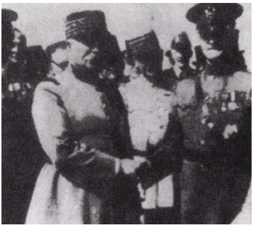
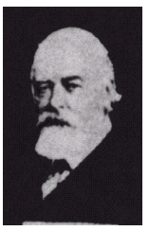
History of Digital Image Processing (cont.)
Mid to late 1920s: Improvements to the Bartlane system resulted in higher quality images
New reproduction processes based on photographic techniques
Increased number of tones in reproduced images
Improved digital image
Early 15 tone digital image

Slide 11
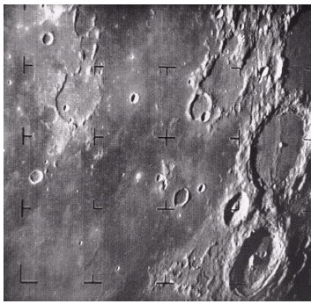
History of Digital Image Processing (cont.)
1960s: Improvements in computing technology and the onset of the space race led to a surge of work in digital image processing
1964: Computers used to improve the quality of images of the moon taken by the Ranger 7 probe
Such techniques were used in other space missions including the Apollo landings
A picture of the moon taken by the Ranger 7 probe minutes before landing

Slide 12
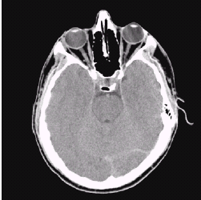
History of Digital Image Processing (cont.)
1970s: Digital image processing begins to be used in medical applications
1979: Sir Godfrey N. Hounsfield & Prof. Allan M. Cormack share the Nobel prize in medicine for the invention of tomography, the technology behind computerised axial tomography (CAT) scans
Typical head slice CAT image

Slide 13
History of Digital Image Processing (cont.)
1980s - Today: The use of Digital Image Processing techniques has exploded and they are now used for all kinds of tasks in all kinds of areas
Image enhancement/restoration
Artistic effects
Medical visualisation
Industrial inspection
Law enforcement
Human computer interfaces

Slide 14
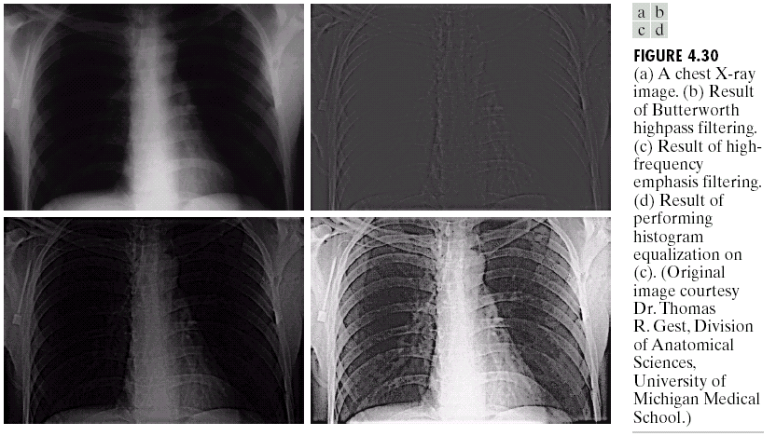
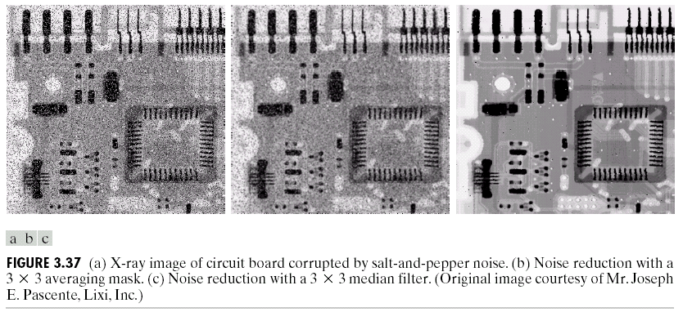
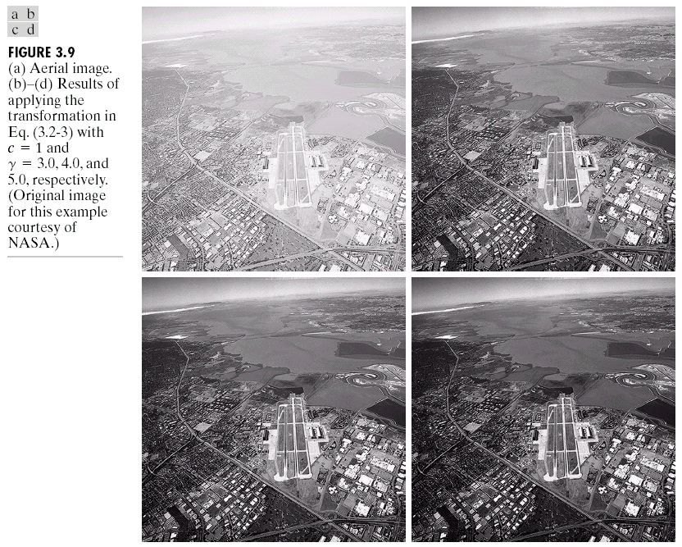
Examples :- Image Enhancement
One of the most common uses of DIP techniques: improve quality, remove noise etc

Slide 15
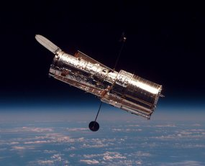
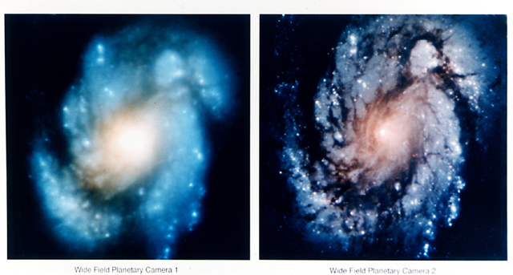
Examples :- The Hubble Telescope
Launched in 1990 the Hubble telescope can take images of very distant objects.
However, an incorrect mirror made many of Hubble’s images useless.
Image processing techniques were used to fix this.

Slide 16
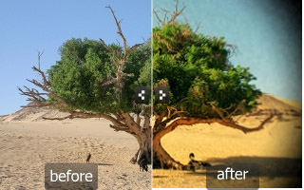
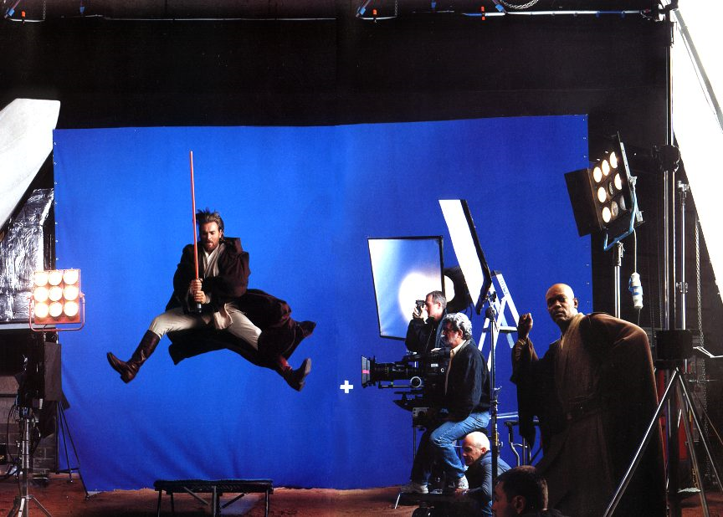
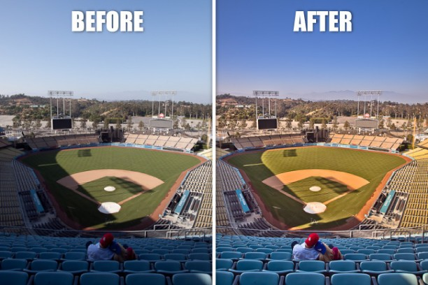
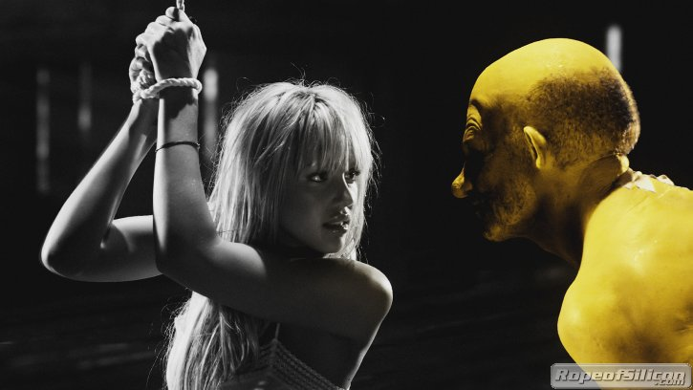
Examples:- Artistic Effects
Artistic effects are used to make images more visually appealing, to add special effects and to make composite images

Slide 17
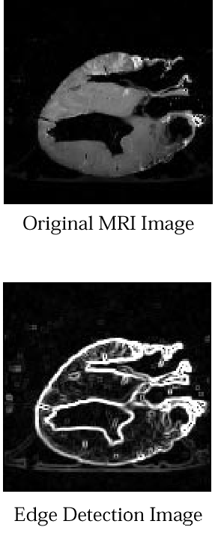
Examples:- Medical
Take slice from MRI scan of canine heart, and find boundaries between types of tissue
Image with gray levels representing tissue density
Use a suitable filter to highlight edges
Original MRI Image of a Dog Heart
Edge Detection Image

Slide 18
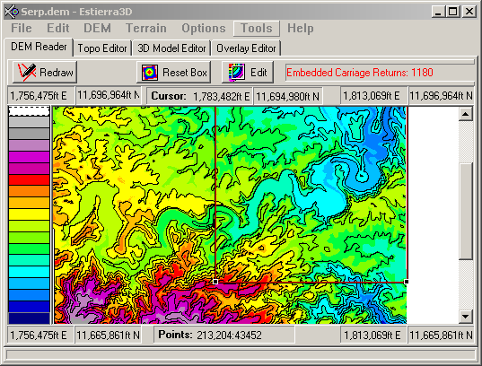
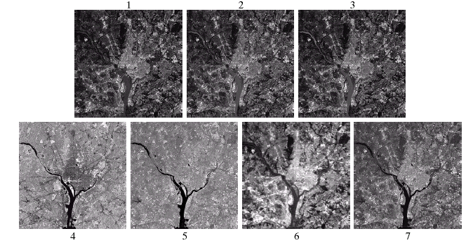
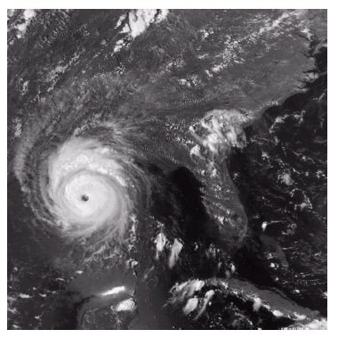
Examples:- GIS
Geographic information systems
Digital image processing techniques are used extensively to manipulate satellite imagery
Terrain classification
Meteorology

Slide 19
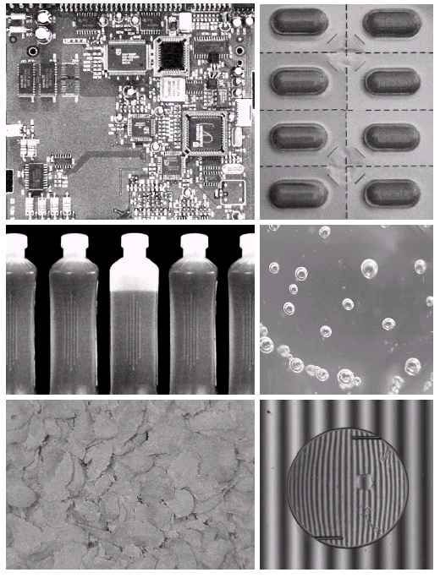
Examples:- Industrial Inspection
Human operators are expensive, slow and unreliable
Make machines do the job instead
Industrial vision systems are used in all kinds of industries
Can we trust them?

Slide 20
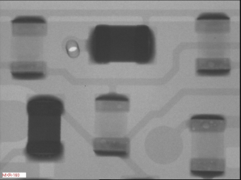
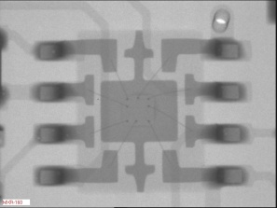
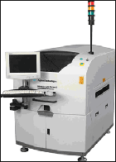
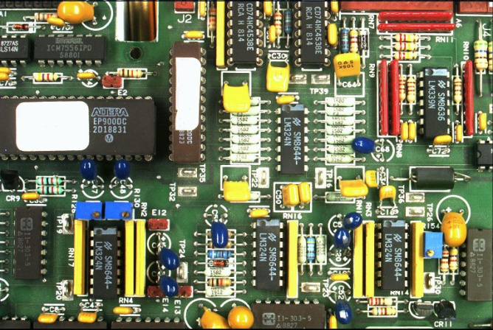
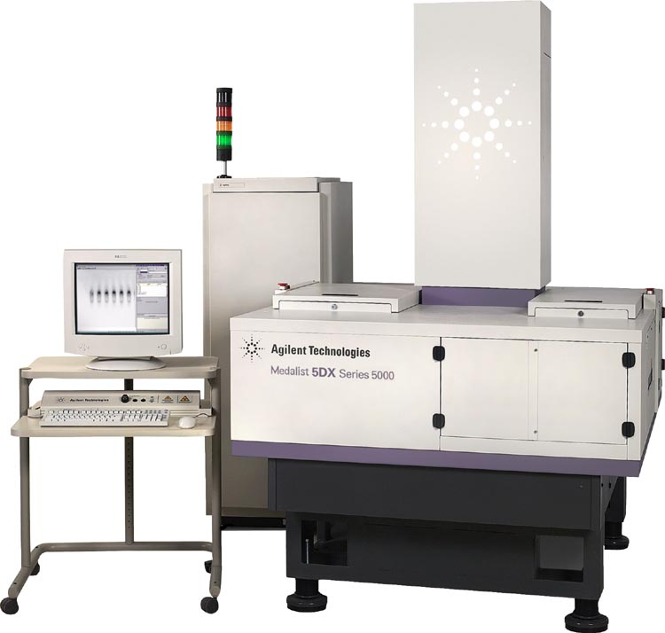
Examples:- PCB Inspection
Printed circuit board (PCB) inspection
Machine inspection is used to determine that all components are present and that all solder joints are acceptable.
Both conventional imaging and x-ray imaging are used.

Slide 21
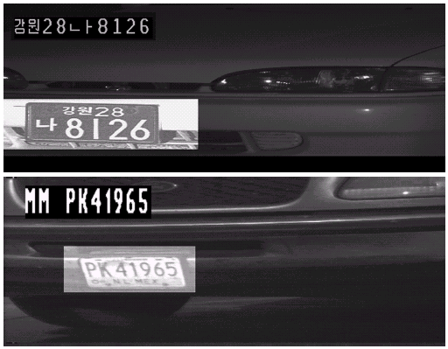
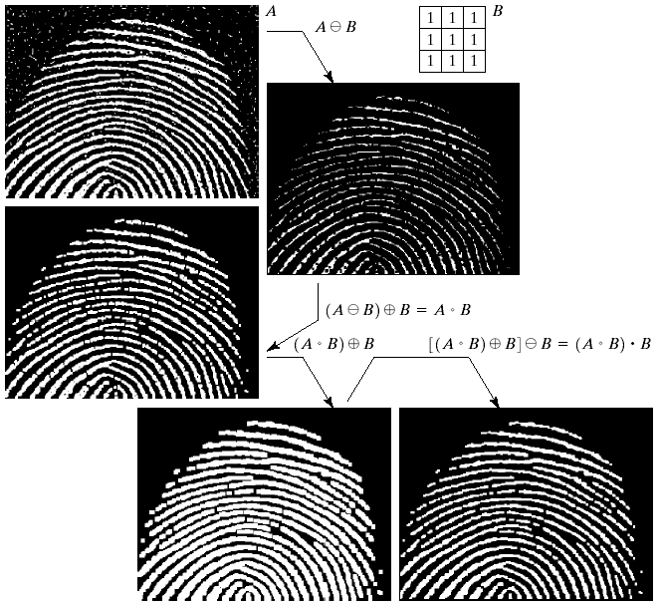
Examples:- Law Enforcement
Image processing techniques are used extensively by law enforcers
Number plate recognition for speed cameras/automated toll systems
Fingerprint recognition
Enhancement of CCTV images

Slide 22

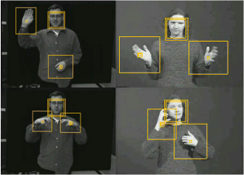
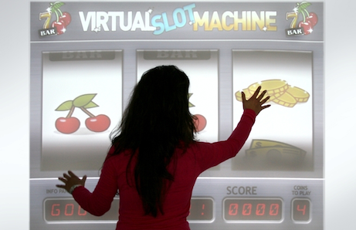
Examples:- Human Computer Interaction (HCI)
Design and use of computer technology, focusing particularly on the interfaces between people (users) and computers.
Try to make human computer interfaces more natural
Face recognition
Gesture recognition

Slide 23
Key Stages in Digital Image Processing
Image Restoration
Morphological Processing
Image Enhancement
Segmentation
Image Acquisition
Object Recognition
Representation & Description
Problem Domain
Colour Image Processing
Image Compression

Slide 24


Key Stages in Digital Image Processing: Image Acquisition
Image Restoration
Morphological Processing
Image Enhancement
Segmentation
Image Acquisition
Object Recognition
Images taken from Gonzalez & Woods, Digital Image Processing (2002)
Representation & Description
Problem Domain
Colour Image Processing
Image Compression
Notes:
This is the first step or process of the fundamental steps of digital image processing. Image acquisition could be as simple as being given an image that is already in digital form. Generally, the image acquisition stage involves preprocessing, such as scaling etc.
Get the image into computer – CCD camera, scanner

Slide 25
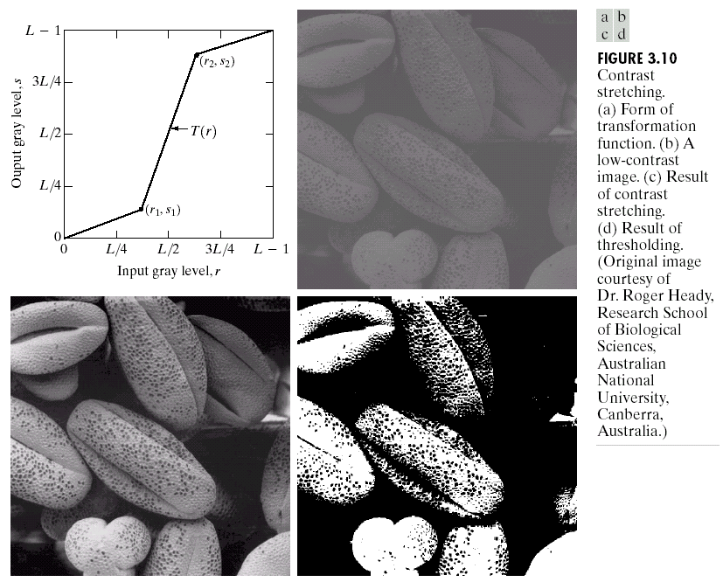
Key Stages in Digital Image Processing: Image Enhancement
Image Restoration
Morphological Processing
Image Enhancement
Segmentation
Image Acquisition
Object Recognition
Images taken from Gonzalez & Woods, Digital Image Processing (2002)
Representation & Description
Problem Domain
Colour Image Processing
Image Compression
Notes:
Image enhancement is among the simplest and most appealing areas of digital image processing. Basically, the idea behind enhancement techniques is to bring out detail that is obscured, or simply to highlight certain features of interest in an image. Such as, changing brightness & contrast etc.
Process an image to produce a better result that is suitable for a particular application. Tasks involve:
Sharpening or de-blurring an out of focus image
Highlighting edges
Improving image contrast ; brightening an image
Removing noise

Slide 26
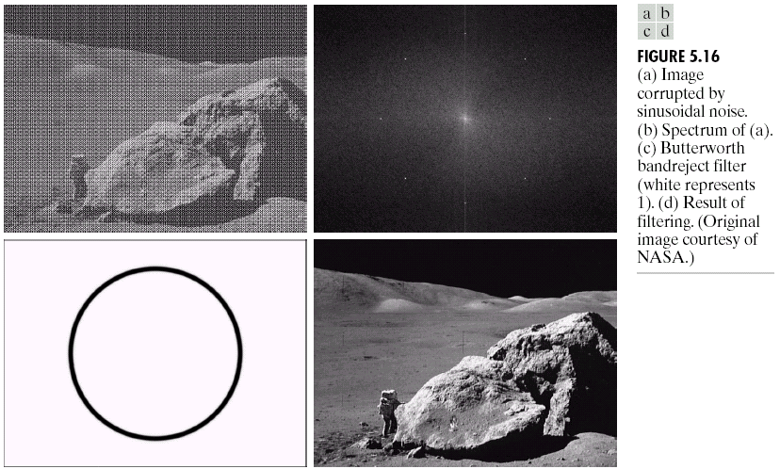
Key Stages in Digital Image Processing: Image Restoration
Image Restoration
Morphological Processing
Image Enhancement
Segmentation
Image Acquisition
Object Recognition
Images taken from Gonzalez & Woods, Digital Image Processing (2002)
Representation & Description
Problem Domain
Colour Image Processing
Image Compression
Notes:
Image restoration is an area that also deals with improving the appearance of an image. However, unlike enhancement, which is subjective, image restoration is objective, in the sense that restoration techniques tend to be based on mathematical or probabilistic models of image degradation.
Reversing the damage done to an image by a known cause. Tasks involve:
Removing of blur cause by linear motion
Removal of optical distortions
Removing periodic interference

Slide 27
Key Stages in Digital Image Processing: Morphological Processing
Image Restoration
Morphological Processing
Image Enhancement
Segmentation
Image Acquisition
Object Recognition
Images taken from Gonzalez & Woods, Digital Image Processing (2002)
Representation & Description
Problem Domain
Colour Image Processing
Image Compression
Notes:
Morphological processing deals with tools for extracting image components that are useful in the representation and description of shape.

Slide 28
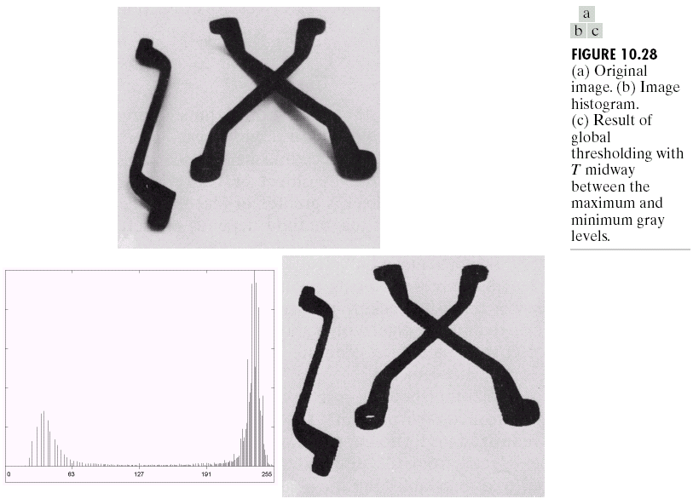
Key Stages in Digital Image Processing: Segmentation
Image Restoration
Morphological Processing
Image Enhancement
Segmentation
Image Acquisition
Object Recognition
Images taken from Gonzalez & Woods, Digital Image Processing (2002)
Representation & Description
Problem Domain
Colour Image Processing
Image Compression
Notes:
Segmentation procedures partition an image into its constituent parts or objects. In general, autonomous segmentation is one of the most difficult tasks in digital image processing. A rugged segmentation procedure brings the process a long way toward successful solution of imaging problems that require objects to be identified individually.
Subdividing an image into constituent parts, or isolating certain aspects of an image. Tasks involve:
Finding lines, circles or particular shapes in an image
Identify cars, trees, human, building or even roads.

Slide 29
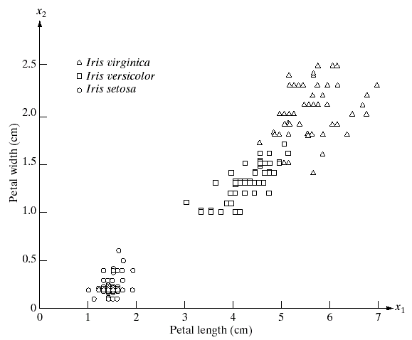
Key Stages in Digital Image Processing: Object Recognition
Image Restoration
Morphological Processing
Image Enhancement
Segmentation
Image Acquisition
Representation & Description
Images taken from Gonzalez & Woods, Digital Image Processing (2002)
Object Recognition
Problem Domain
Colour Image Processing
Image Compression
Notes:
Representation and description almost always follow the output of a segmentation stage, which usually is raw pixel data, constituting either the boundary of a region or all the points in the region itself. Choosing a representation is only part of the solution for transforming raw data into a form suitable for subsequent computer processing. Description deals with extracting attributes that result in some quantitative information of interest or are basic for differentiating one class of objects from another.

Slide 30
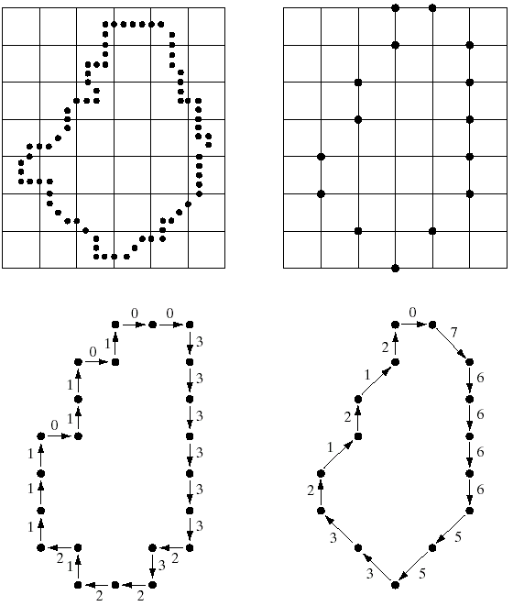
Key Stages in Digital Image Processing: Representation & Description
Image Restoration
Morphological Processing
Image Enhancement
Segmentation
Image Acquisition
Representation & Description
Images taken from Gonzalez & Woods, Digital Image Processing (2002)
Object Recognition
Problem Domain
Colour Image Processing
Image Compression
Notes:
Recognition is the process that assigns a label, such as, “vehicle” to an object based on its descriptors.

Slide 31
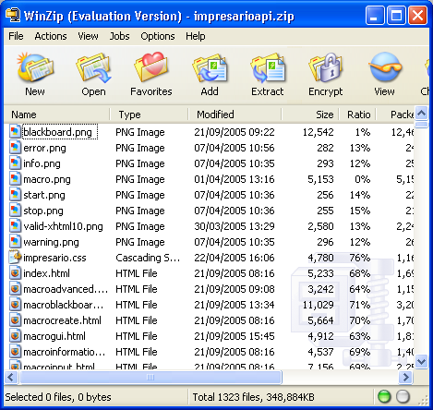
Key Stages in Digital Image Processing: Image Compression
Image Restoration
Morphological Processing
Image Enhancement
Segmentation
Image Acquisition
Object Recognition
Representation & Description
Problem Domain
Colour Image Processing
Image Compression

Slide 32
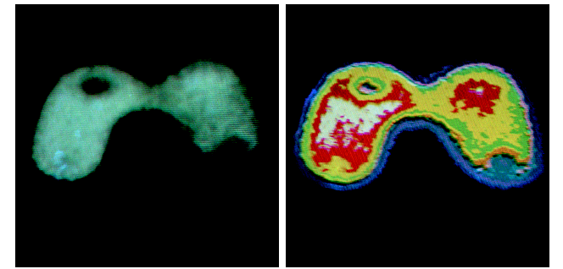
Key Stages in Digital Image Processing: Colour Image Processing
Image Restoration
Morphological Processing
Image Enhancement
Segmentation
Image Acquisition
Object Recognition
Representation & Description
Problem Domain
Colour Image Processing
Image Compression

Slide 33
Computer vision
Concerned with the theory behind artificial systems that extract information from images
Examples of applications of CV:
Controlling process
Detecting events
Organizing information
Modeling objects or environments
Interaction
Produces 3D models from image data

Slide 34
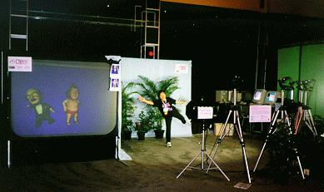
What is Computer Vision?
Deals with the development of the theoretical and algorithmic basis by which useful information about the 3D world can be automatically extracted and analyzed from a single or multiple to 2D images of the world.

Slide 35
Computer Vision, Also Known As ...
Image analysis
Scene analysis
Image understanding

Slide 36
Some Related Disciplines
Image processing
Computer graphics
Pattern recognition
Robotics
Artificial intelligence

Slide 37
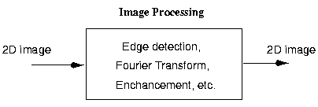
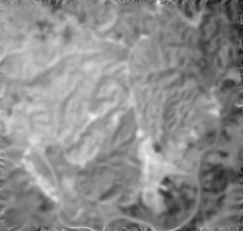
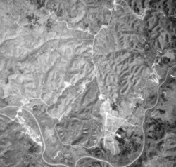
Image Processing
Image enhancement

Slide 38
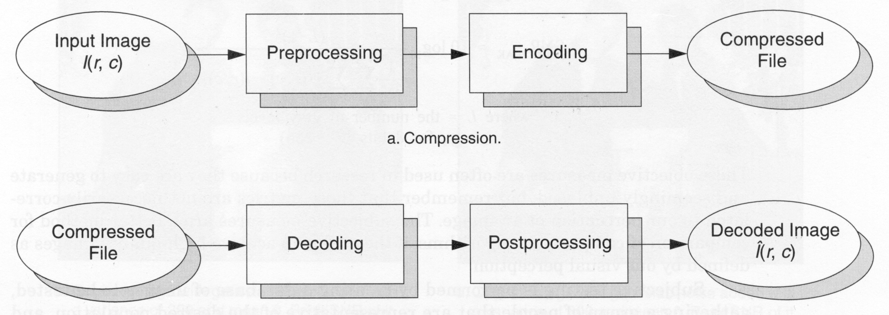
Image Processing (cont’d)
Image compression

Slide 39
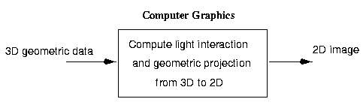
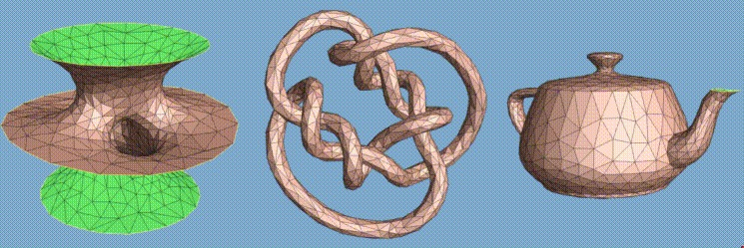
Computer Graphics
Geometric modeling

Slide 40
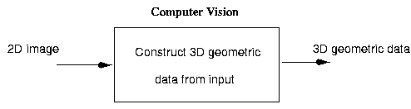
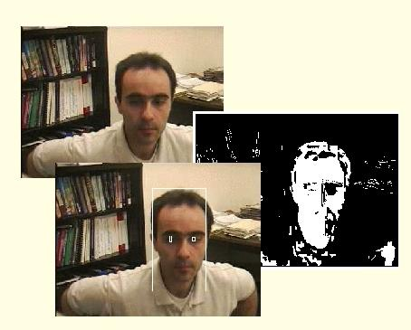
Computer Vision

Slide 41
Robotic Vision
Application of computer vision in robotics.
Some important applications include :
Autonomous robot navigation
Inspection and assembly

Slide 42
Pattern Recognition
Has a very long history (research work in this field started in the 60s).
Concerned with the recognition and classification of 2d objects mainly from 2d images.
Many classic approaches only worked under very constrained views (not suitable for 3d objects).
It has triggered much of the research which led to today’s field of computer vision.
Many pattern recognition principles are used extensively in computer vision.

Slide 43
Artificial Intelligence
Concerned with designing systems that are intelligent and with studying computational aspects of intelligence.
It is used to analyze scenes by computing a symbolic representation of the scene contents after the images have been processed to obtain features.
Many techniques from artificial intelligence play an important role in many aspects of computer vision.
Computer vision is considered a sub-field of artificial intelligence.

Slide 44
Why is Computer Vision Difficult?
It is a many-to-one mapping
A variety of surfaces with different material and geometrical properties, possibly under different lighting conditions, could lead to identical images
Inverse mapping has non unique solution (a lot of information is lost in the transformation from the 3D world to the 2D image)
It is computationally intensive
We do not understand the recognition problem

Slide 45
Practical Considerations
Impose constraints to recover the scene
Gather more data (images)
Make assumptions about the world
Computability and robustness
Is the solution computable using reasonable resources?
Is the solution robust?
Industrial computer vision systems work very well
Make strong assumptions about lighting conditions
Make strong assumptions about the position of objects
Make strong assumptions about the type of objects

Slide 46
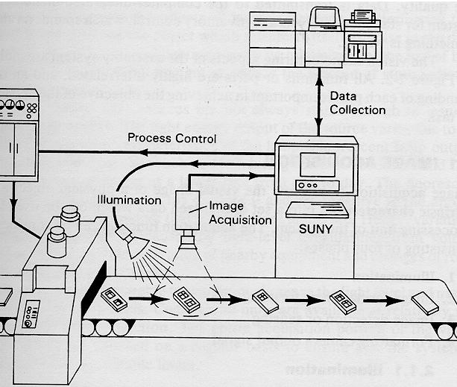
An Industrial Computer Vision System

Slide 47

The Three Processing Levels
Low-level processing
Standard procedures are applied to improve image quality
Procedures are required to have no intelligent capabilities.

Slide 48

The Three Processing Levels (cont’d)
Intermediate-level processing
Extract and characterize components in the image
Some intelligent capabilities are required.

Slide 49


The Three Processing Levels (cont’d)
High-level processing
Recognition and interpretation.
Procedures require high intelligent capabilities.

Slide 50

Recognition Cues
Scene interpretation, even of complex, cluttered scenes is a straightforward task for humans.

Slide 51

Recognition Cues (cont’d)
How are we able to discern reality and an image of reality? What clues are present in the image? What knowledge do we use to process this image?

Slide 52

The role of color
What is this object? Does color play a role in recognition? Might this be easier to recognize from a different view?

Slide 53



The role of texture
Characteristic image texture can help us readily recognize objects.

Slide 54

The role of shape

Slide 55

The role of grouping

Slide 56
Computer Vision Applications
Industrial inspection/quality control
Surveillance and security
Face recognition
Gesture recognition
Space applications
Medical image analysis
Autonomous vehicles
Virtual reality and much more …...

Slide 57


Character Recognition

Slide 58

Document Handling

Slide 59

Signature Verification

Slide 60

Biometrics

Slide 61



Fingerprint Identification
Minutiae Matching
Delaunay Triangulation

Slide 62

Indexing into Databases
Shape content

Slide 63


Traffic Monitoring

Slide 64


Face Detection

Slide 65

Facial Expression Recognition

Slide 66

Human Activity Recognition

Slide 67


Morphing
http://www.morphthing.com/
Notes:
Morphing is a special effect in motion pictures and animations that changes (or morphs) one image or shape into another through a seamless transition.

